Slide 1





Course Name object oriented analysis and design
CSC 2210
(Undergraduate)
Software engineering (Undergraduate)
Chapter 8 component & deployment diagram
M. Mahmudul hasan
Assistant Professor, CS, AIUB
http://www.dit.hua.gr/~m.hasan

Slide 2
Component
Slide-2
Modularity is an attribute of software that allows a program to be intellectually manageable into distinct logical parts
Modularity is the degree to which a system's components are logically separated into distinct parts called module and recombined again
Modular unit with well-defined interfaces that is replaceable within its environment
Specifies a CONTRACT of the services that it provides to its clients and that it requires from others components in terms of its provided and required interfaces
A component is encapsulated, its internals are hidden and inaccessible
Its dependencies are designed such that it can be treated as independently as possible

Slide 3

Component notation
Slide-3
A Component is shown as a rectangle with
A keyword <<component>>
Optionally, in the right hand corner a component icon can be displayed (a component icon is a rectangle with two smaller rectangles sticking out from left-hand side, this symbol is a visual stereotype)
The component Name
Components can be labelled with a stereotype (categorize). There are a number of standard stereotypes , example <<entity>> <<subsystem>>

Slide 4
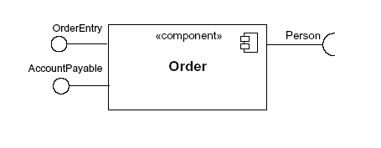
Component elements: interface
Slide-4
An interface provides only the operations but not the implementation
A Component defines its behaviour in terms of provided and required interfaces (input and output from/to the interface)
Provided Interface
Characterize services that the component offers to its environment
Is modeled using a ball, labelled with the name, attached by a solid line to the component
Required Interface
Characterize services that the component expects from its environment
Is modeled using a socket, labelled with the name, attached by a solid line to the component.

Slide 5

Component elements: interface
Slide-5
Where two components provide and require the same interface, these two notations may be combined

Slide 6
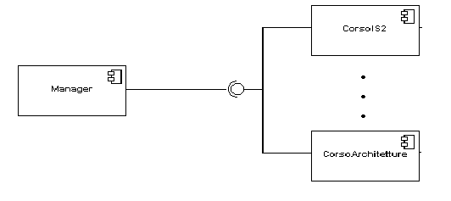
Component elements: interface
Slide-6
In a system context where there are multiple components that require or provide a particular component, a notation can be used that combines by joining the components.

Slide 7
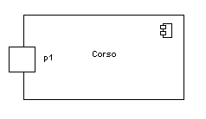
Component elements: port
Slide-7
All interactions of a component with its environment are achieved through a port
Specifies a distinct interaction point:
Between that component and its environment
Between that component and its internal parts
Is shown as a small square symbol
Ports can be named, and the name is placed near the square symbol
Is associated with the interfaces that specify the nature of the interactions (provided, required) that may occur over a port

Slide 8
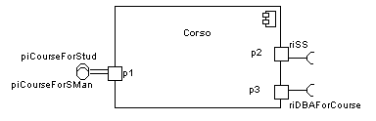

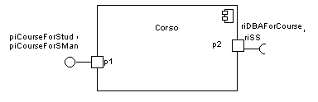
Component elements: port
Slide-8
Ports can support un-idirectional communication or bi-directional communication
If there are multiple interfaces associated with a port, these interfaces may be listed with the interface icon, separated by a commas

Slide 9

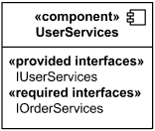
Component diagram: external view
Slide-9
A component has external view and internal view
An external view (or black box view) shows publicly visible properties and operations
An external view of a component is by means of interface symbols sticking out of the component box to communicate outside
The interface can be listed in the compartment of a component box

Slide 10
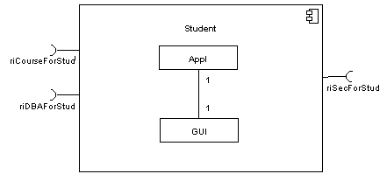
Component diagram: internal view
Slide-10
An internal, or white box view of a component is where the realizing classes/components are nested within the component shape
Realization is a relationship between two set of model elements

Slide 11
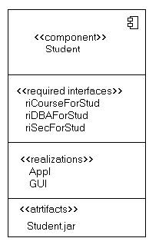
Component diagram: internal view
Slide-11
The internal classes (e.g. App, GUI) that realize the behavior of a component may be displayed in an additional compartment
Compartments can also be used to display connectors or implementation artifacts
An artifact is the specification of a phisycal piece of information

Slide 12

Component diagram: connector
Slide-12
Assembly Connector
A connector between two components defines that one component provides the services that another component requires
It must only be defined from a required interface to a provided interface
An assembly connector is notated by a “ball-and-socket” connection
The interfaces provided and required must be compatible

Slide 13
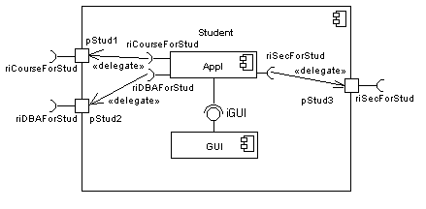
Component diagram: connector
Slide-13
Delegation Connector
Links the external contract of a component to the internal realization
Represents the forwarding of signals
It must only be defined between used interfaces or ports of the same kind (between two required connection)
For provided interface arrow direct to internal component

Slide 14
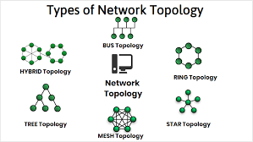
Deployment diagram
Slide-14
There is a strong link between components diagrams and deployment diagrams
Deployment diagrams
Show the physical relationship between hardware and software in a system
Hardware elements:
Computers (clients, servers)
Embedded processors (microprocessor)
Devices (sensors)
Are used to show the nodes where software components reside in the run-time system

Slide 15
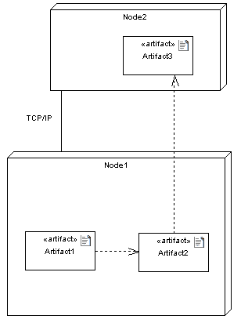
Deployment diagram
Slide-15
Deployment diagrams contain artifact
An artifact
Is the specification of a phisycal piece of information
Ex: source files, binary executable files, table in a database system, etc.
An artifact defined by the user, represents a concrete element in the physical world

Slide 16
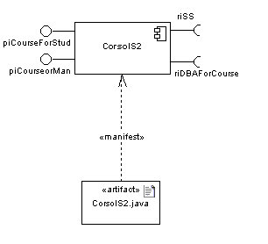
Deployment diagram
Slide-16
An artifact manifest one or more model elements
A <<manifestation>> is the concrete physical of one or more model elements by an artifact
This model element often is a component
A manifestation is notated as a dashed line with an open arrow-head labeled with the keyword <<manifest>>

